Slide 1



MEGALEO HOSPITAL SCHEDULER
PRESENTATION BY GROUP 9

Slide 2
Megaleo hospital scheduler is a data-powered website set aside to help provide hospitals with the ability to structure and coordinate their activities to ensure an effective and highly productive work output, increasing work efficiency and better care services for patients.
The website helps hospital personnel in various departments to effectively communicate with regards to patient details to help solve the problem of patient details being interchanged resulting in poor health care being provided to the patients and help speed-up processes to prevent congestion.

Slide 3
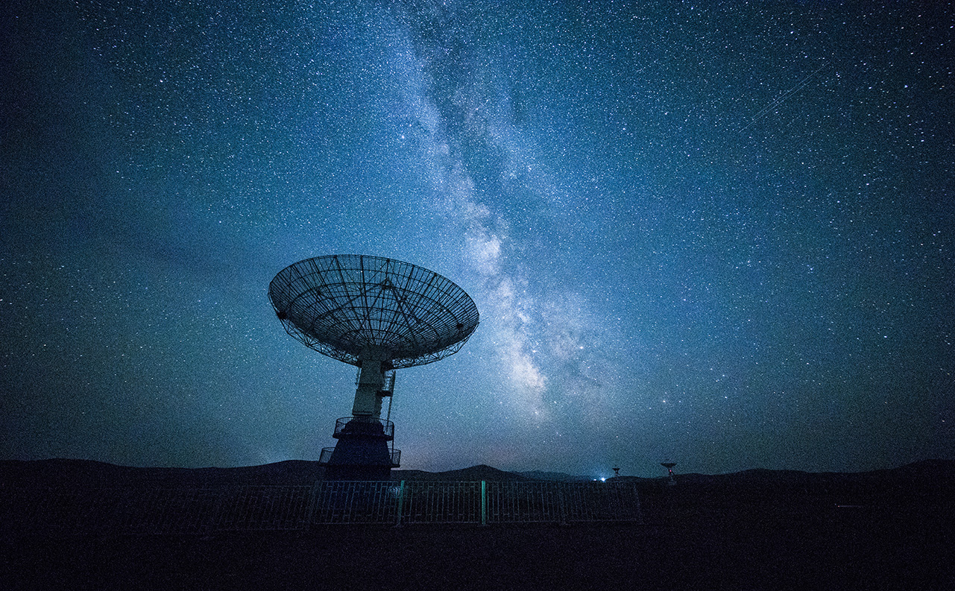


Operation/functionalities
Pharmacy Breast Cancer
Covid Dentist
Surgery
Consultation

Slide 4
Architecture and design
Server Level
Presentation Level
HTML,CSS & JavaScript
Database Level
MySQL, PhpMyAdmin

Slide 5

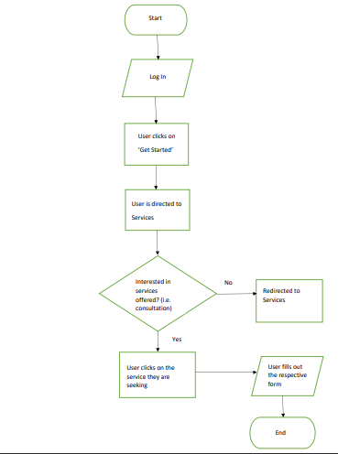
FRAMEWORK USED, FLOWCHART & ROLE EACH MEMBER PLAYED
Bootstrap was the framework that was used in creating the frontend
PHP framework was used for the backend.
Ayeyi Mills – Coordinated as the project manager and helped with both
the backend and the frontend creation.
Bright Augustt- Focused on creating the frontend and helped in creating
the backend.
Carole – Helped with the backend and also created the flowchart
Rhiana --

Slide 6
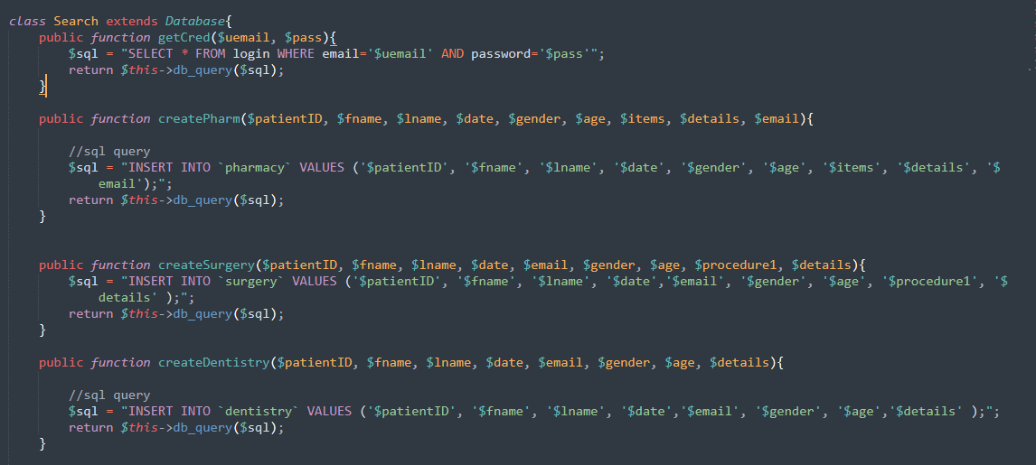
SNIPPETS OF CODE

Slide 7
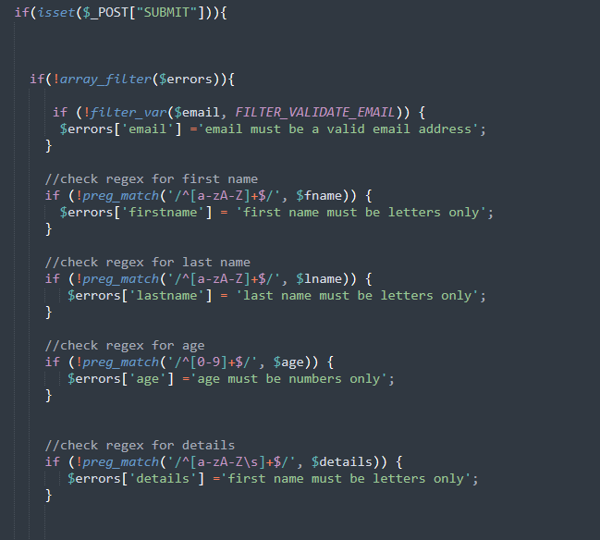
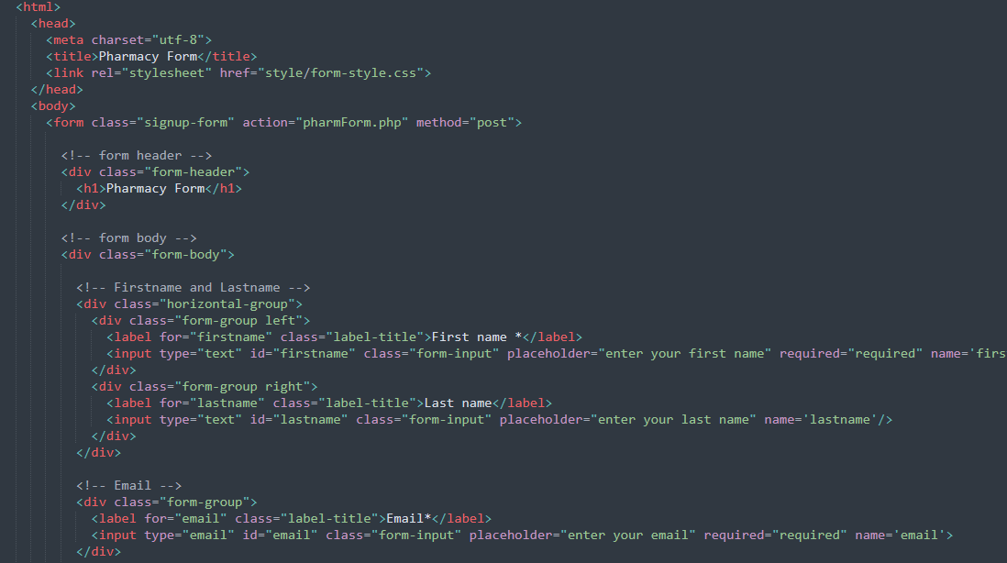
SNIPPETS OF CODE

Slide 8
Thank You!
DEMO

